Slide 1
Design and Simulation of Different Types of Infinite Impulse Response (IIR) Filters
Experiment no#3

Slide 2
Butterworth Filter
Chebyshev Filter : Type -1 and Type-2
Elliptic Filter

Slide 3
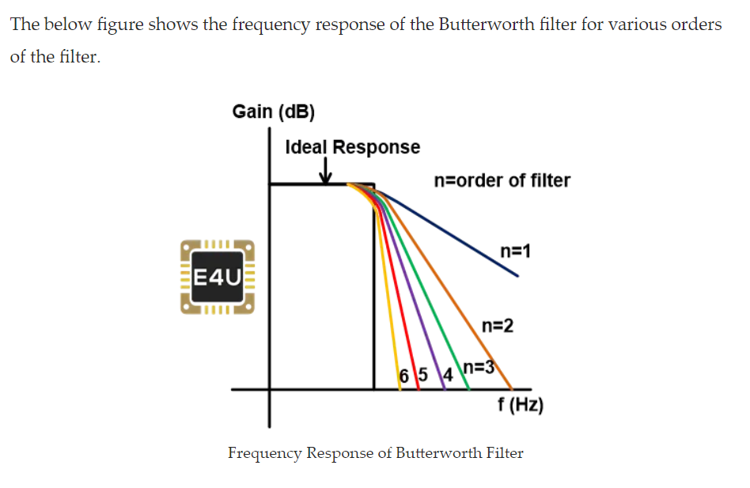
Various order of Butterworth filter

Slide 4
Design a 10th order band pass (BP) Butterworth filter with a passband from 100 to 200 Hz and plot both impulse response and frequency response.

Slide 5
Impulse response and frequency response
Fs=1000;% Fs=1000 i.e. sampling frequency
n=10; %order of the filter
Wn=[100 200]/500; %normalized by Fs/2
Normalized frequency Wn can vary between 0 and 1 %Normalization is done by Fs/2, here Wn = 0.2 to 0.4 [b,a]=butter(n,Wn);
figure(1)
[y,t]=impz(b,a,101); % 101 samples of impulse response plot(t,y)
title('Impulse Response') grid on
figure(2) freqz(b,a,512, Fs) title('Frequency Response')

Slide 6
Step response??
For the above mentioned problem
Step response <<- >> Impulse response

Slide 7
Step Response
Fs=1000;% Fs=1000 i.e. sampling frequency
n=10; %order of the filter
Wn=[100 200]/500; %normalized by Fs/2
[b,a]=butter(n,Wn);
stepz(b,a)
grid on

Slide 8
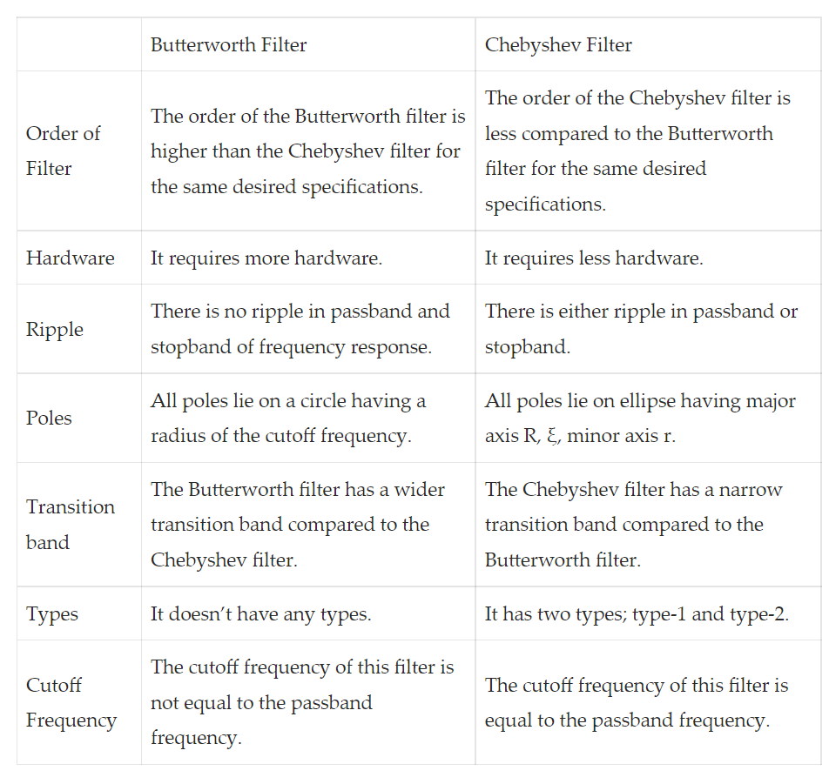
Differences between Butterworth and Chebyshev filter

Slide 9
Question 2
Design a 10th order BP Chebyshev filter of type-I with a passband from 100 to 200 Hz and plot the impulse response and frequency response. Consider 25dB ripple in passband.

Slide 10
Fs=1000;
n=10;
Rp=25;
Wn=[100 200]/(Fs/2);
[b,a]=cheby1(n,Rp,Wn); % For stop band [b,a]=cheby1(n,Rp,Wn,’stop’);
[y,t]=impz(b,a,101);
figure(1)
plot(t,y) grid on
title('Impulse Response')
figure(2)
freqz(b, a, 512, Fs)
title('Frequency Response')

Slide 11
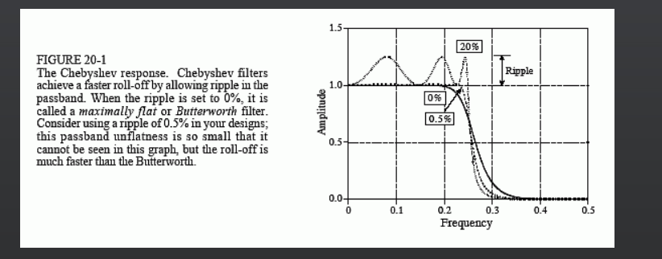
Chebyshev Filter

Slide 12
Elliptic Filter: Question 3
Design a 10th order BP elliptic filter with passband in the range of 100 to 200 Hz. Plot the frequency response and impulse response of the filter. Consider 5dB ripple in passband and 20dB attenuation in stopband.

Slide 13
Fs=1000; %Sampling Frequency
n=10;
Rp=5;
Rs=20; % Rs dB down from peak value in pass-band
Wn=[100 200]/(Fs/2);
[b,a]=ellip(n,Rp,Rs,Wn);
figure(1);
freqz(b,a,512,Fs); %512 samples
title('Frequency Response')
figure(2);
[y,t]=impz(b, a, 500); % here 500 means number of samples
plot(t,y)
grid on
title('Impulse response of Elliptic filter')

Slide 14
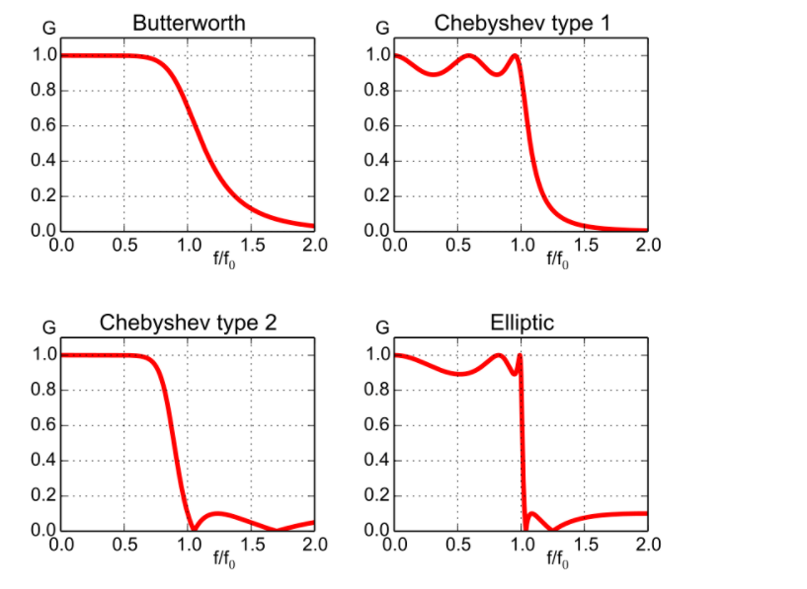
Comparison

Slide 15
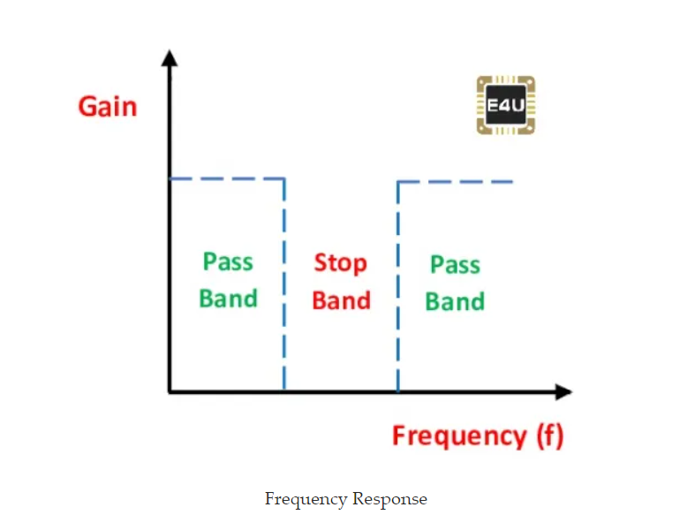
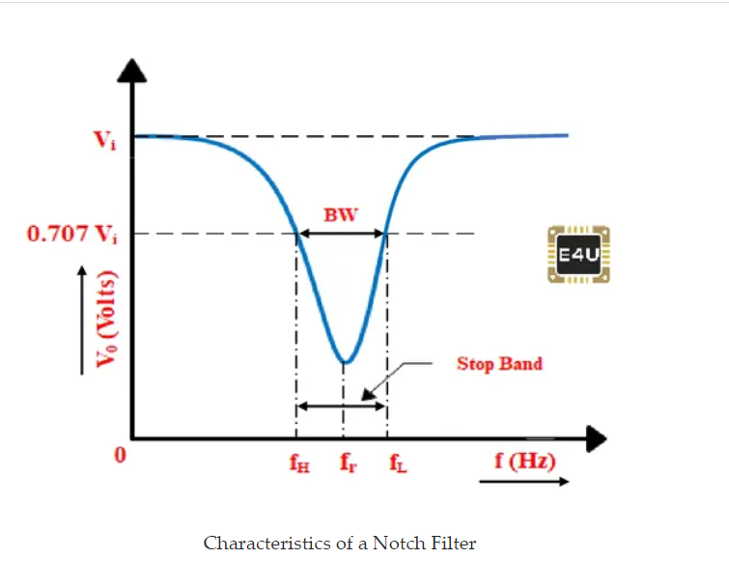
Notch filter (Bandstop)

Slide 16
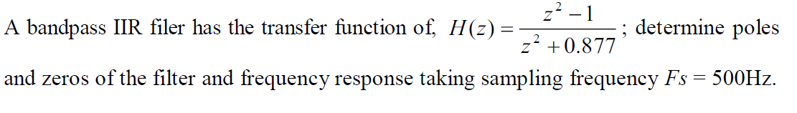

Question 4
P =
0 + 0.9365i
0 - 0.9365i
=
-1 1

Slide 17
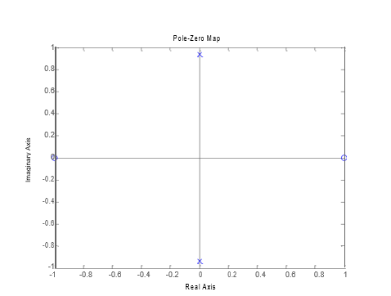
Pole-zero diagram

Slide 18
Solution
b=[1, 0, 1]; %numerator
a=[1, 0, 0.877];% denominator
Fs=500;
freqz(b, a, 512, Fs); %512 samples

Slide 19
Question 5
b=[1, 0, 1]; %numerator
a=[1, 0, -0.877];% denominator
Fs=500;
freqz(b, a, 512, Fs); %512 samples

